Slide 1
Eclat Algorithm

Slide 2
Outline
What is ECLAT Algorithm??
ECLAT Algorithm Example

Slide 3
ECLAT Algorithm
ECLAT stands for Equivalence Class Clustering and Bottom-up Lattice Traversal
ECLAT Algorithm uses a Depth-First search approach and uses less memory than Apriori Algorithm
ECLAT does not perform repeated scanning of the data to compute individual support values.

Slide 4





1
2
3
4
5
6
7
8
9

Slide 5
Transaction | Milk | Egg | Bread | Butter | Ketchup
1 | 1 | 1 | 0 | 0 | 1
2 | 0 | 1 | 0 | 1 | 0
3 | 0 | 1 | 1 | 0 | 0
4 | 1 | 1 | 0 | 1 | 0
5 | 1 | 0 | 1 | 0 | 0
6 | 0 | 1 | 1 | 0 | 0
7 | 1 | 0 | 1 | 0 | 0
8 | 1 | 1 | 1 | 0 | 1
9 | 1 | 1 | 1 | 0 | 0

Slide 6
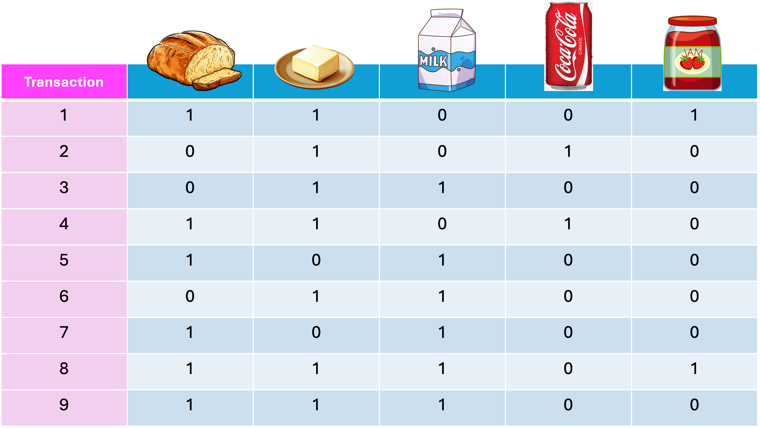
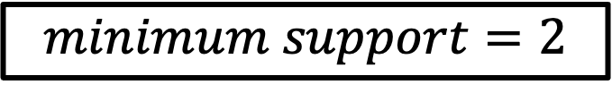
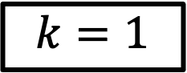
$$k=1$$
$$minimum support=2$$
Item set | TransactionID set | Support
 | {1,4,5,7,8,9} | 6
 | {1,2,3,4,6,8,9} | 7
 | {3,5,6,7,8,9} | 6
 | {2,4} | 2
 | {1,8} | 2

Slide 7
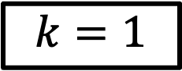
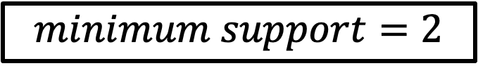
$$k=1$$
Item set | TransactionID set | Support
$$minimum support=2$$
Item set | TransactionID set | Support
 | {1,4,5,7,8,9} | 6
 | {1,2,3,4,6,8,9} | 7
 | {3,5,6,7,8,9} | 6
 | {2,4} | 2
 | {1,8} | 2

Slide 8
$$k=1$$
Item set | TransactionID set | Support
$$minimum support=2$$
Item set | TransactionID set | Support
 | {1,4,5,7,8,9} | 6
 | {1,2,3,4,6,8,9} | 7
 | {3,5,6,7,8,9} | 6
 | {2,4} | 2
 | {1,8} | 2

Slide 9
$$k=1$$
Item set | TransactionID set | Support
$$minimum support=2$$
Item set | TransactionID set | Support
 | {1,4,5,7,8,9} | 6
 | {1,2,3,4,6,8,9} | 7
 | {3,5,6,7,8,9} | 6
 | {2,4} | 2
 | {1,8} | 2

Slide 10
$$k=1$$
Item set | TransactionID set | Support
$$minimum support=2$$
Item set | TransactionID set | Support
 | {1,4,5,7,8,9} | 6
 | {1,2,3,4,6,8,9} | 7
 | {3,5,6,7,8,9} | 6
 | {2,4} | 2
 | {1,8} | 2

Slide 11
$$k=1$$
Item set | TransactionID set | Support
 | {1,4,8,9} | 4
 | {5,7,8,9} | 4
 | {4} | 1
 | {1,8} | 2
 | {3,6,8,9} | 4
 | {2,4} | 2
 | {1,8} | 2
 | {} | 0
 | {8} | 0
 | {} | 0
$$minimum support=2$$
Item set | TransactionID set | Support
 | {1,4,5,7,8,9} | 6
 | {1,2,3,4,6,8,9} | 7
 | {3,5,6,7,8,9} | 6
 | {2,4} | 2
 | {1,8} | 2

Slide 12
$$k=1$$
Item set | TransactionID set | Support
 | {1,4,8,9} | 4
 | {5,7,8,9} | 4
 | {4} | 1
 | {1,8} | 2
 | {3,6,8,9} | 4
 | {2,4} | 2
 | {1,8} | 2
 | {} | 0
 | {8} | 0
 | {} | 0
$$minimum support=2$$
Item set | TransactionID set | Support
 | {1,4,5,7,8,9} | 6
 | {1,2,3,4,6,8,9} | 7
 | {3,5,6,7,8,9} | 6
 | {2,4} | 2
 | {1,8} | 2

Slide 13
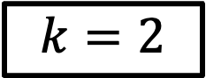
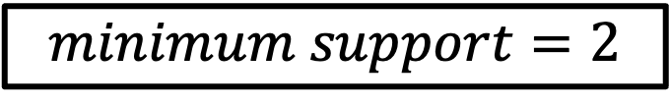
$$k=2$$
$$minimum support=2$$
Item set | TransactionID set | Support
 | {1,4,8,9} | 4
 | {5,7,8,9} | 4
 | {1,8} | 2
 | {3,6,8,9} | 4
 | {2,4} | 2
 | {1,8} | 2
Item set | TransactionID set | Support
 | {8,9} | 2
 | {1,8} | 2
 | {4} | 1
 | {8} | 1

Slide 14
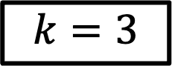
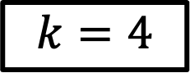
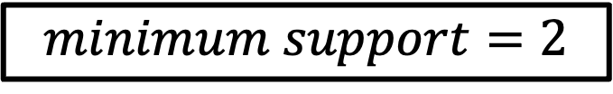
$$k=3$$
$$minimum support=2$$
Item set | TransactionID set | Support
 | {8,9} | 2
 | {1,8} | 2
$$k=4$$
Item set | TransactionID set | Support
 | {8} | 1

Slide 15
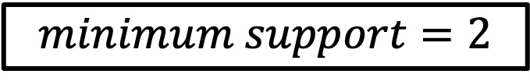
$$minimum support=2$$
Item set | Frequency | Support
 | {1,4,8,9} | 4
 | {5,7,8,9} | 4
 | {1,8} | 2
 | {3,6,8,9} | 4
 | {2,4} | 2
 | {1,8} | 2
 | {8,9} | 2
 | {1,8} | 2
Item bought | Recommended Product

Slide 16
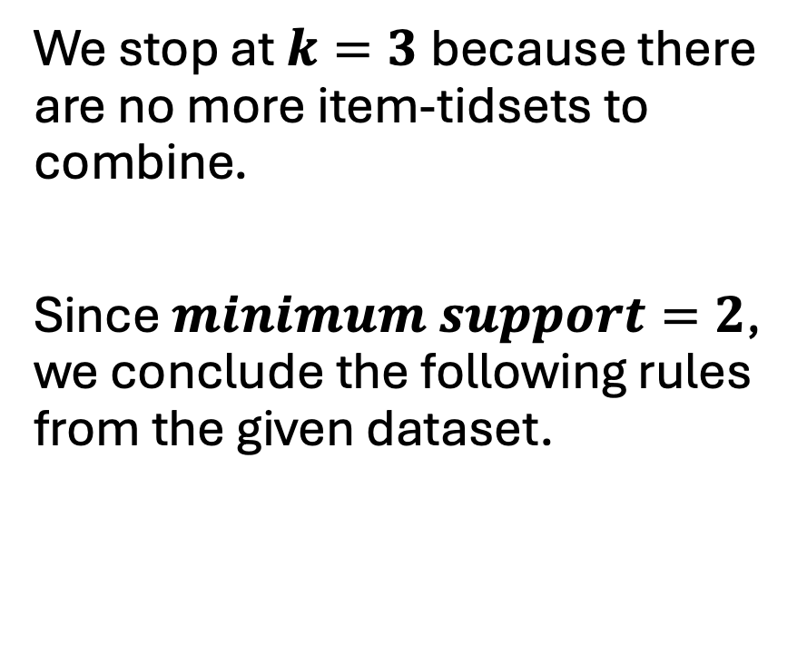
$$minimum support=2$$
We stop at $k=3$because there are no more item-tidsets to combine.
Since $minimum support=2$, we conclude the following rules from the given dataset.
Item bought | Recommended Product

